Slide 1



Introduction to Databases
How do RDBMS work?
Databases
Basics
SoftUni Team
Technical Trainers
Software University
http://softuni.bg

Slide 2

Table of Content
Database Engine
Database Relationships
Database Programmability

Slide 3
Questions
sli.do #3216

Slide 4

Database Engine

Slide 5
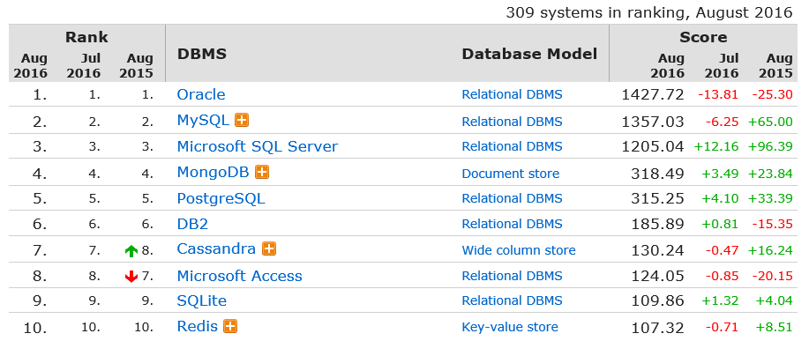
Top Database Engines
Source: http://db-engines.com/en/ranking

Slide 6





Client-Server Model
CLIENTS
TCP/IP
DATABASE
Notes:
Relational Database Management Systems (RDBMS) are based on a Client-Server model. Normally, clients communicate with the database over (Transmission Control Protocol/Internet Protocol) TCP/IP protocol. TCP/IP is a basic communication language over the internet. It has two layers: - TCP – it is assembling the communication into smaller packages transferred through the internet and received by another TCP which reassembles the packages into the original communication. - IP – responsible for the addresses in order communication to get to the right destination
Here are some of the default ports that databases are using: - MySQL - 3306 - SQL Server - 1433 - Oracle - 1521 Clients – it begins the communication with the server. SQL Server and MySQL have different clients. SQL Server uses SQL Server Management Studio(SSMS). MySQL has many: HeidiSQL, MySQL Workbench etc.

Slide 7


Download Clients & Servers
MY SQL Community Edition
https://dev.mysql.com/downloads/installer/ http://www.heidisql.com/download.php
SQL Server Express Edition
https://www.microsoft.com/en-us/download/ details.aspx?id=52679

Slide 8
SQL Server Logical Architecture
INSTANCE
DATABASE
DATABASE
SCHEMA
TABLE
TABLE
TABLE
TABLE
TABLE
TABLE
TABLE
TABLE
TABLE
Notes:
When you make an SQL Server installation you get a single Instance. This is where the Databases are located. You can have many Databases which contain Schemas. You can treat the architecture as a subfolders. Tables are the main unit of data storage. They are located in Schemas. The default one is called dbo.
When you have the following table [SoftUni].[dbo].[Employees] it means that [SoftUni] is the database [dbo] is the schema and [Employees] is the table.

Slide 9
MySQL Logical Architecture
INSTANCE
DATABASE = SCHEMA
DATABASE = SCHEMA
TABLE
TABLE
TABLE
TABLE
TABLE
TABLE
TABLE
TABLE
TABLE
Notes:
MySQL has a similar logical architecture. The first layer is the Instance. It has many Databases which are also called Schemas. Databases(Schemas) contains Tables. The following record : soft_uni.employees means that the Database(Schema) s soft_uni and the table name is employees.

Slide 10
Table
Column
CustomerID | FirstName | Birthdate | CityID
1 | Brigitte | 03/12/1975 | 101
2 | August | 27/05/1968 | 102
3 | Benjamin | 15/10/1988 | 103
4 | Denis | 07/01/1993 | 104
Cell
Row
Data
Int
String
Date
Data Types
Notes:
The table is the main unit of data storage. It has rows, columns and cells. Cells contain stored data. Each column has a data type. Types can be VARCHAR(String), INT, DATE etc.

Slide 11
Engine’s Role
CustomerID | FirstName | Birthdate | CityID
1 | Brigitte | 03/12/1975 | 101
2 | August | 27/05/1968 | 102
3 | Benjamin | 15/10/1988 | 103
4 | Denis | 07/01/1993 | 104
Select
Delete
Update
105
Insert
5 | John | 09/11/1932 | 105
Create
City_ID | City_Name
101 | Munich
102 | Berlin
Notes:
The engine of the database is responsible for the complete functioning. Some of the more essential functions are: - Select – selects data from the table - Delete – deletes data from the table
- Update – update data in the table - Insert – inserts data in the table - Create – creates objects in the database
- Alter – changes objects in the database - Drop – deletes objects from the database
- Truncate – deletes all the data in a table

Slide 12
SQL
SQL
DDL
CREATE ALTER DROP TRUNCATE
DML
SELECT INSERT UPDATE DELETE
DCL
GRANT REVOKE DENY
TCL
BEGIN TRAN COMMIT ROLLBACK SAVE
Notes:
SQL(Structured Query Language) is the main language to access the database. It has many dialects for the different engines. This means that basically MySQL and SQL Server use different syntax to execute statements. However, SQL is a standard so there are many similarities. SQL is often pronounced as SEQUEL(Structured English Query Language) in the past but it was changed to SQL due to trademarks issues. The language is declarative and it has 4 main sections:
- DDL(Data Definition Language) – responsible for the managing of the main database objects - DML(Data Manipulation Language) – responsible for managing data in the tables - DCL(Data Control Language) – responsible for the permissions in the database - TCL(Transaction Control Language) – responsible for controlling the transactions

Slide 13
Engine’s Behavior
Worker
Worker
Worker
THREADPOOL
Worker
EXECUTION
FREE THREAD
Parsing Compilation Optimization
Query Execution
Task
Plan Cache
Data Cache
CACHE
RESULTS
Task
Task
Database
QUERIES
Network
Network
Notes:
Databases are Client-Server platforms. Whenever the client sends a request it is received by the server through TCP/IP protocol. Requests create tasks which are handled by the thread pool of the database. Threads are in status idle and wait until a task appears. When a task shows up the execution begins. Firstly, the engine creates the execution plan. It says how the query is going to be executed. If there is an existing plan for the query it is used from the cache and no new execution plan generation happens. On the next step, the query checks whether it is in the data cache. It can appear in the data cache if it has been previously executed . If no data is found in the data cache then the data is retrieved from the database itself. Finally, the results are returned through TCP/IP to the client and the thread is released to idle state.

Slide 14
Database Physical Structure
Database
Table
Data File
Log File
File Group
Pages
Notes:
Since we know the logical structure the physical one is a bit different. Every table has files beneath. Files are organized in file groups in SQL Server or tablespaces in MySQL. There are two main types of files: - Data files – contains the physical data - Transaction log files – records all transactions and the database modifications made by each transaction
Each file contains pages. By default they are 8KB for SQL Server and 16KB for MySQL. They can be resized as well. Pages contains the data itself.

Slide 15

Database Relationships

Slide 16
Relationships
Primary key
Foreign key
Primary key
Customers
Cities
CustomerID | FirstName | Birthdate | CityID
1 | Brigitte | 03/12/1975 | 101
2 | August | 27/05/1968 | 102
CityID | CityName
101 | Munich
102 | Berlin
Relationship
Primary key
Orders
OrderID | OrderDate | CustomerID
601 | 12/09/2016 | 1
602 | 13/09/2016 | 1
Foreign key
Notes:
One of the main features that RDBMS provides are the relationships. Technically, it means that values in one of the columns depends on another column from another table. In the example above CityID in table Customers depends on CityID in table Cities.
There are three main type of relationships: - One-to-one - One-to-many
- Many-to-many

Slide 17
Referential Integrity
Primary key
Foreign key
Primary key
Customers
Cities
CustomerID | FirstName | Birthdate | CityID
1 | Brigitte | 03/12/1975 | 101
2 | August | 27/05/1968 | 102
3 | Benjamin | 15/10/1988 | 103
4 | Denis | 07/01/1993 | 104
CityID | CityName
101 | Munich
102 | Berlin
Foreign Key Violation
Notes:
Referential integrity plays a critical role when it comes to database consistency. When we have a relationship between two tables the inserted data should be present in the referent table.
If we have CityID 103 and 104 which don’t exist in Cities the database won let us add those IDs. At the same moment, if we want to delete CityID 101 from Cities it wont be possible because it is used by table Customers.

Slide 18
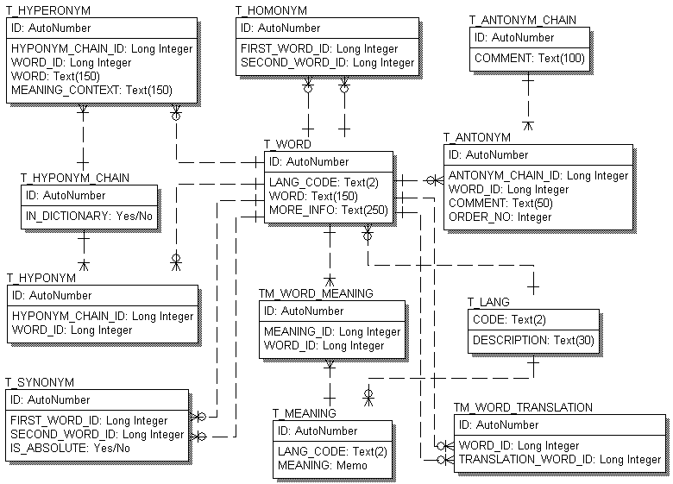
E/R Diagrams

Slide 19

Database Programmability

Slide 20
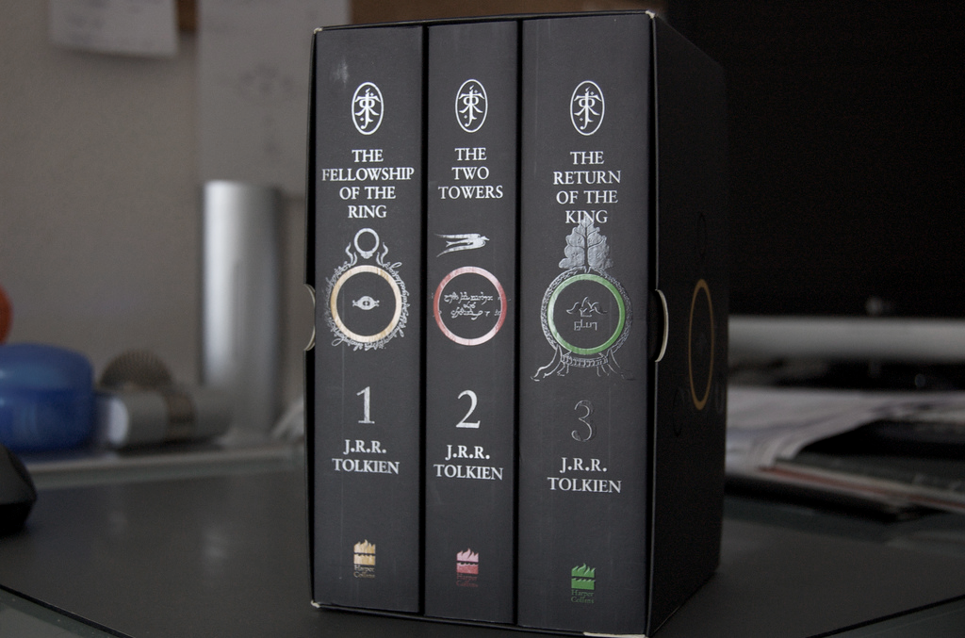
Indinces

Slide 21
Indices
Customer_ID
0 - 200
0 – 100
101-200
101-150
50-100
0-50
150-200
Notes:
Indexes optimize the searches in a table. Their most common structure is a B-Tree. If we have Customer_ID 60 it will go to the node which contains values in the range 50-100 and then it will search only there.

Slide 22

Views

Slide 23
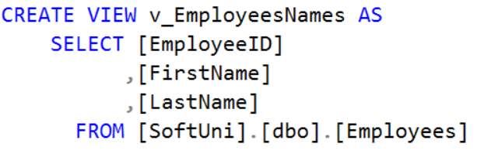
Views
Notes:
Views are objects that show portion of the data. For example, we may show only 3 column even though the table has 9.

Slide 24

Procedures

Slide 25
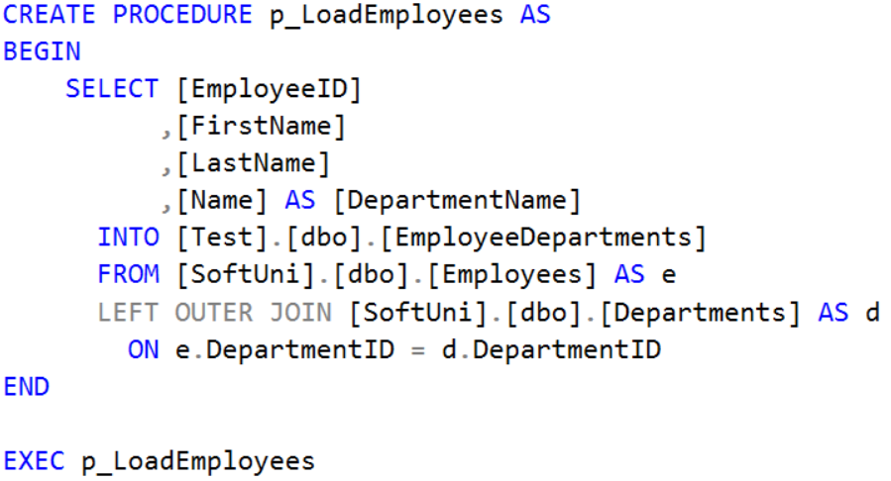
Procedures
Notes:
Procedures are somehow similar to the void methods in the programming. They execute one or more SQL statements in order to achieve some functionality.

Slide 26

Functions

Slide 27
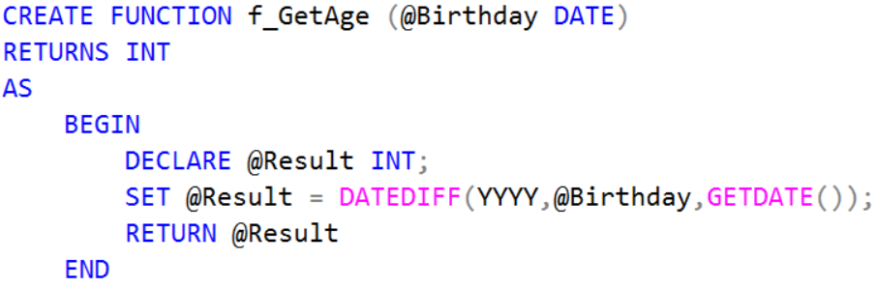
Functions
Notes:
Functions resemble return methods in programming. They execute some logic and return a result of some data type.

Slide 28

Triggers

Slide 29
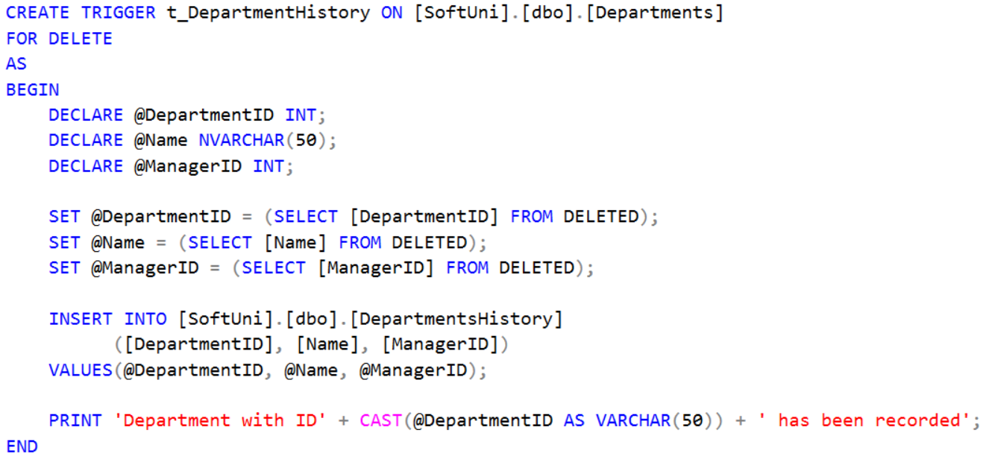
Triggers
Notes:
Triggers are procedures which are bound to a table. They track if an Insert, Update or Delete statements is executed and then they trigger some logic. For example, if you delete a record in a table the trigger will catch the event and may log the deleted record in another table.

Slide 30

Summary
Database Engine
Database Relationships
Database Programmability

Slide 31









Introduction to Databases
https://softuni.bg/courses/

Slide 32
License
This course (slides, examples, demos, videos, homework, etc.) is licensed under the "Creative Commons Attribution-NonCommercial-ShareAlike 4.0 International" license
Attribution: this work may contain portions from
"Databases" course by Telerik Academy under CC-BY-NC-SA license

Slide 33





Free Trainings @ Software University
Software University Foundation – softuni.org
Software University – High-Quality Education, Profession and Job for Software Developers
softuni.bg
Software University @ Facebook
facebook.com/SoftwareUniversity
Software University @ YouTube
youtube.com/SoftwareUniversity
Software University Forums – forum.softuni.bg

